Slide 1
Omega fortress
Hussein Ibrahim

Slide 2
What we build?
We build a 2d game, top down view, using godot engine with gdscript language (it’s similar to Python) our game is about base defense zone, that we have a base in the center of the game we must defend our base from the enemies (that are spawning around the base) by heroes (each hero has his own ability with attack range) palced on a grid system , this grid system can also help the player to build barriers around the base to make a long path to force the enenmies take it

Slide 3


How we build our game
We build our game by creating scenes, when this scenes are combined, the game is formed
Game logo
Godot engine

Slide 4
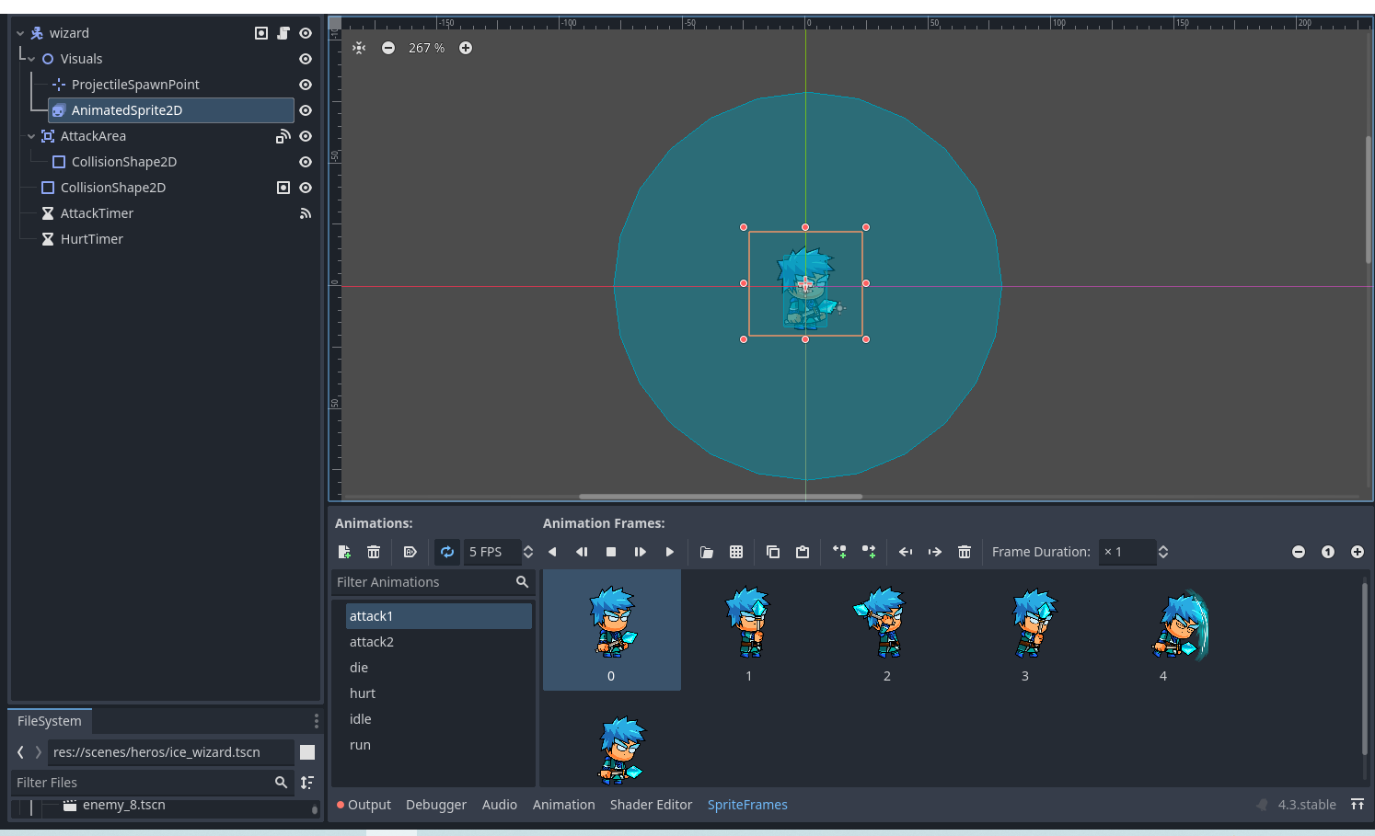
Example of scenes

Slide 5
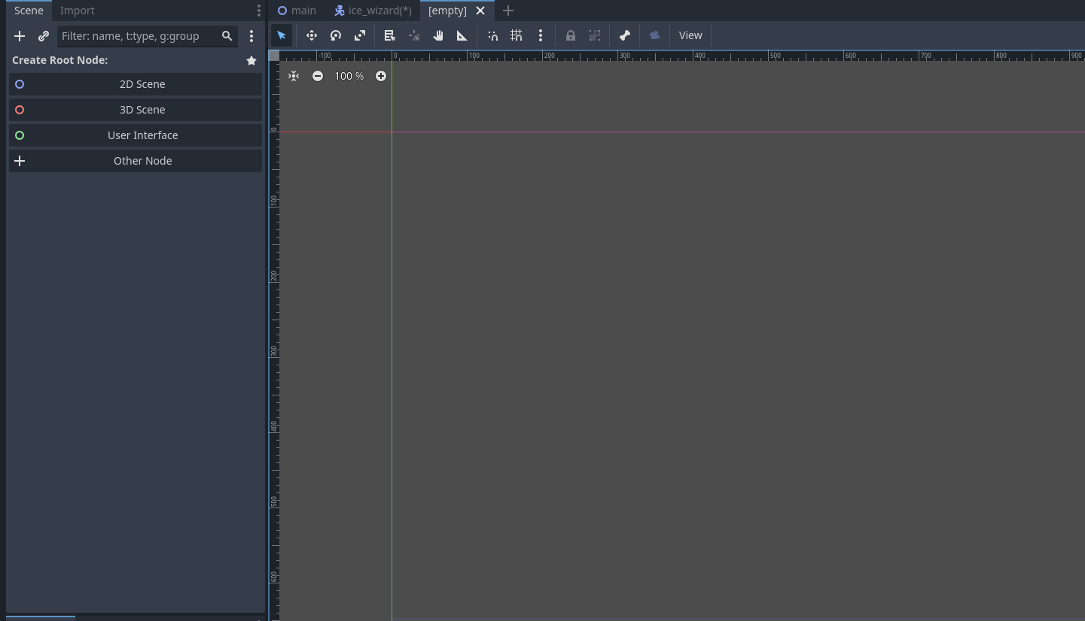
Example of creating a single scene
First, create a new scene by clicking this plus button

Slide 6
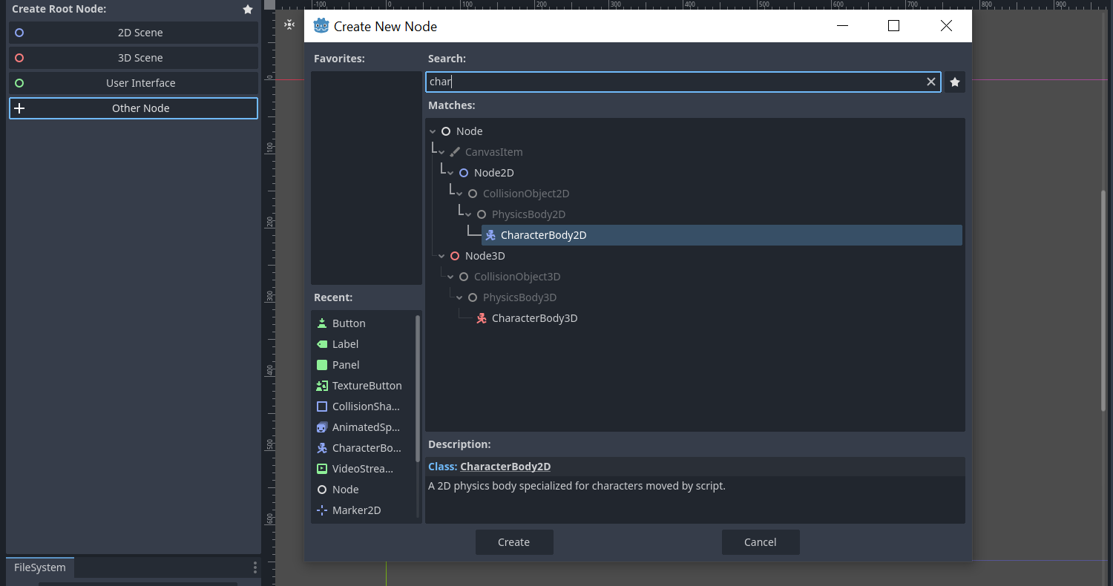
Second step
Click add to choose your specific root node
Choose you node and click create

Slide 7
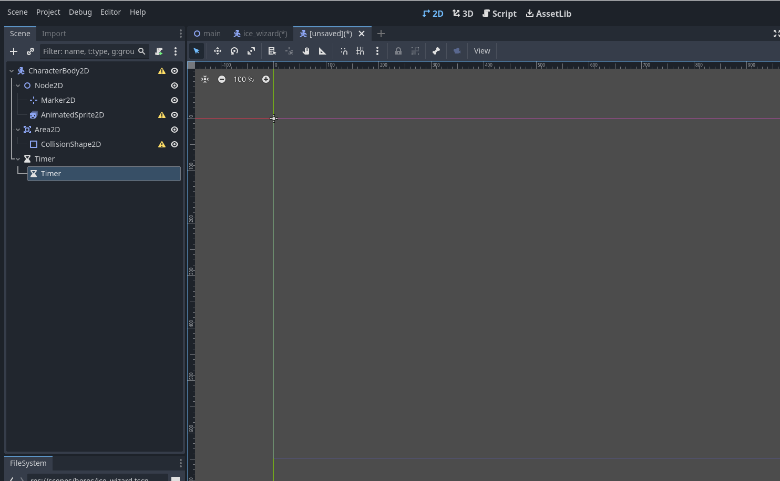
Third step
Add all the needed nodes for your scene. For example, here we will create a character so we need those nodes

Slide 8
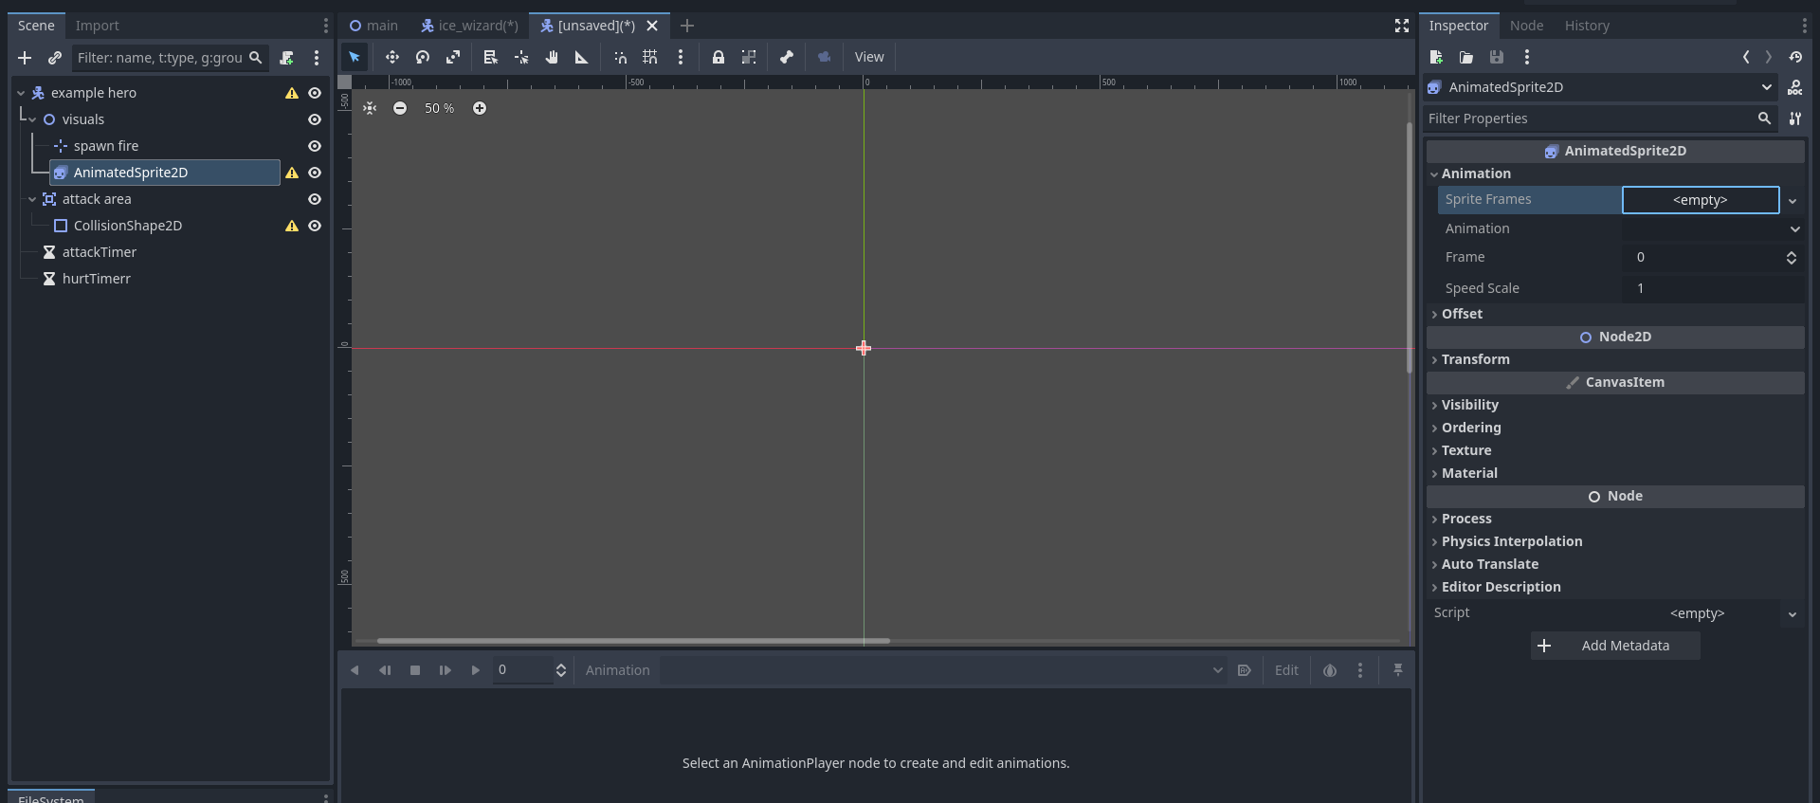
Fourth step
First, start with the animation, choose a new sprite frame, and create it

Slide 9
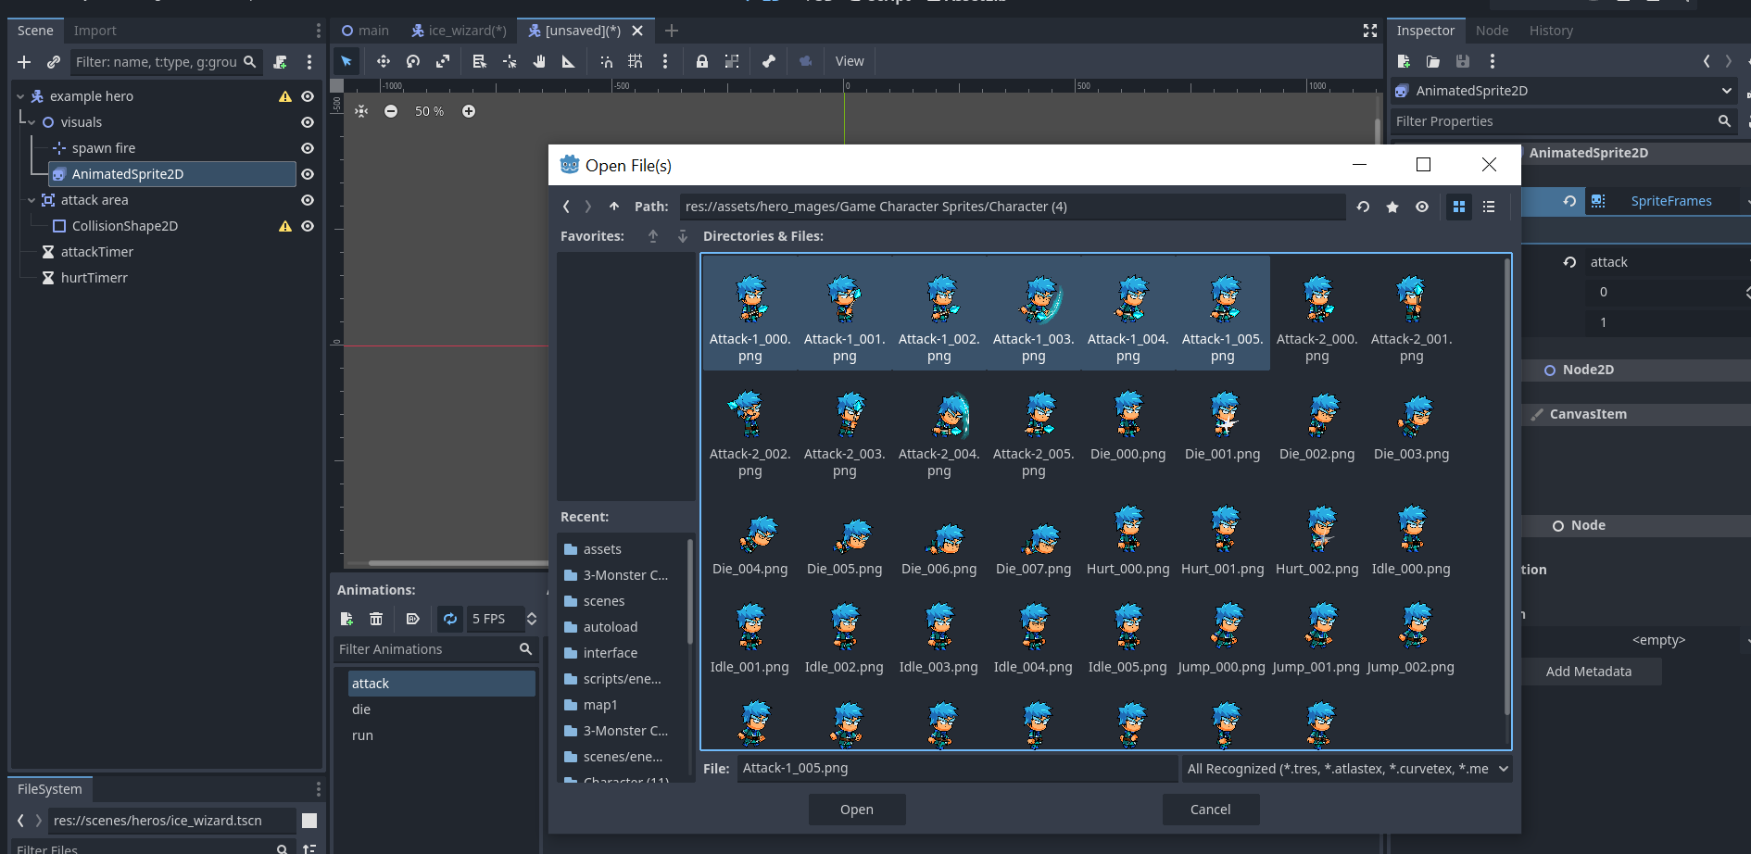
Fifth step
Choose your animation photo from your assets folder that you prepared before
Create your animation needed and name them

Slide 10
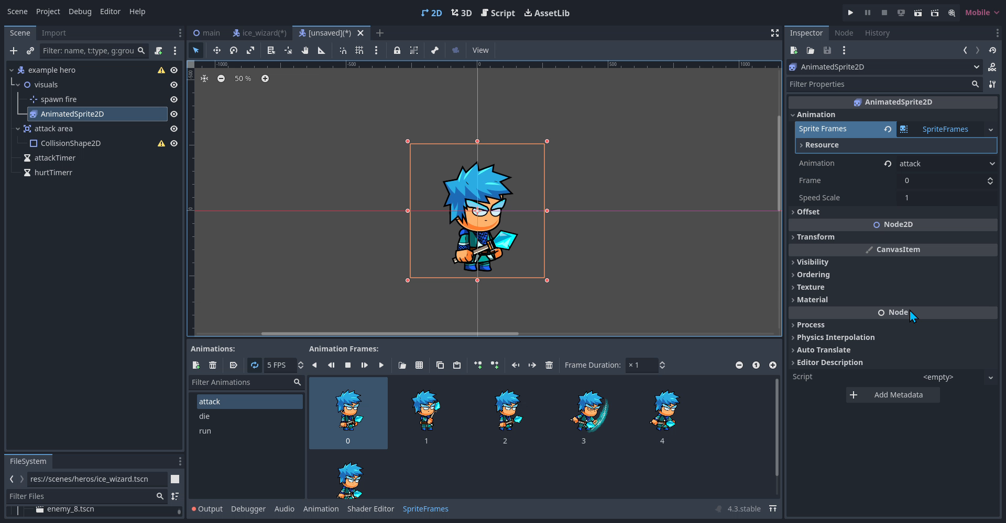
Video showing the animation

Slide 11
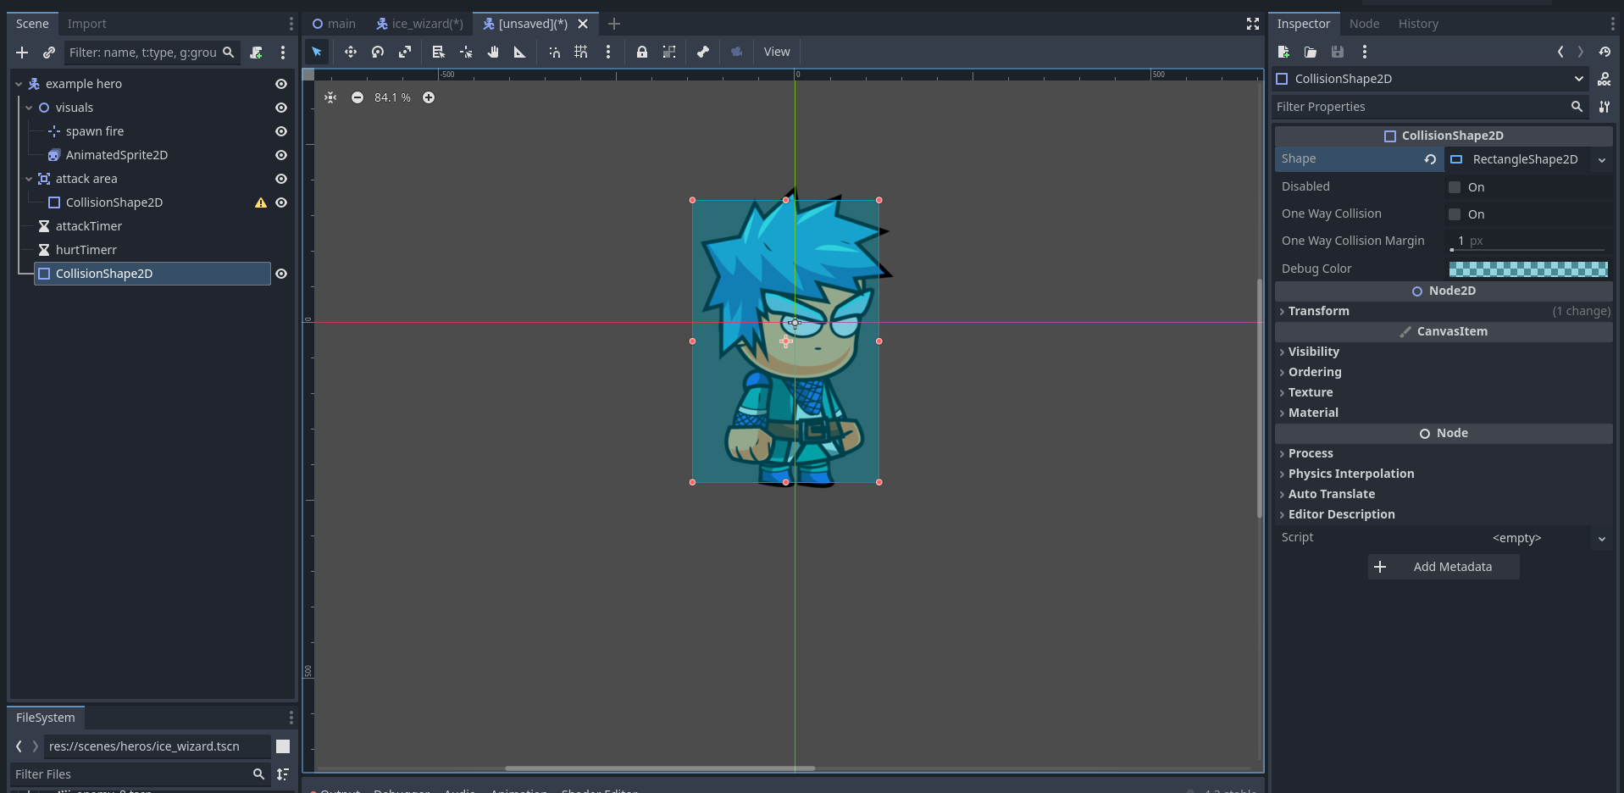
Six step
3- Now add the collision for the character
2-Choose the type of collision you want to use
1- Click on the node to open the inspector
4- And resize it to fill the character

Slide 12
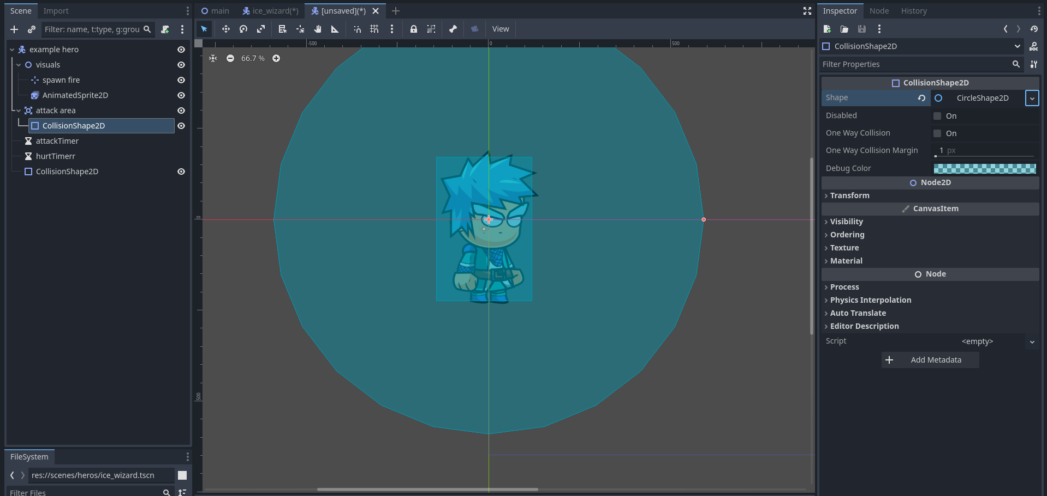
Seventh step
Add a colliasion for the attack area

Slide 13
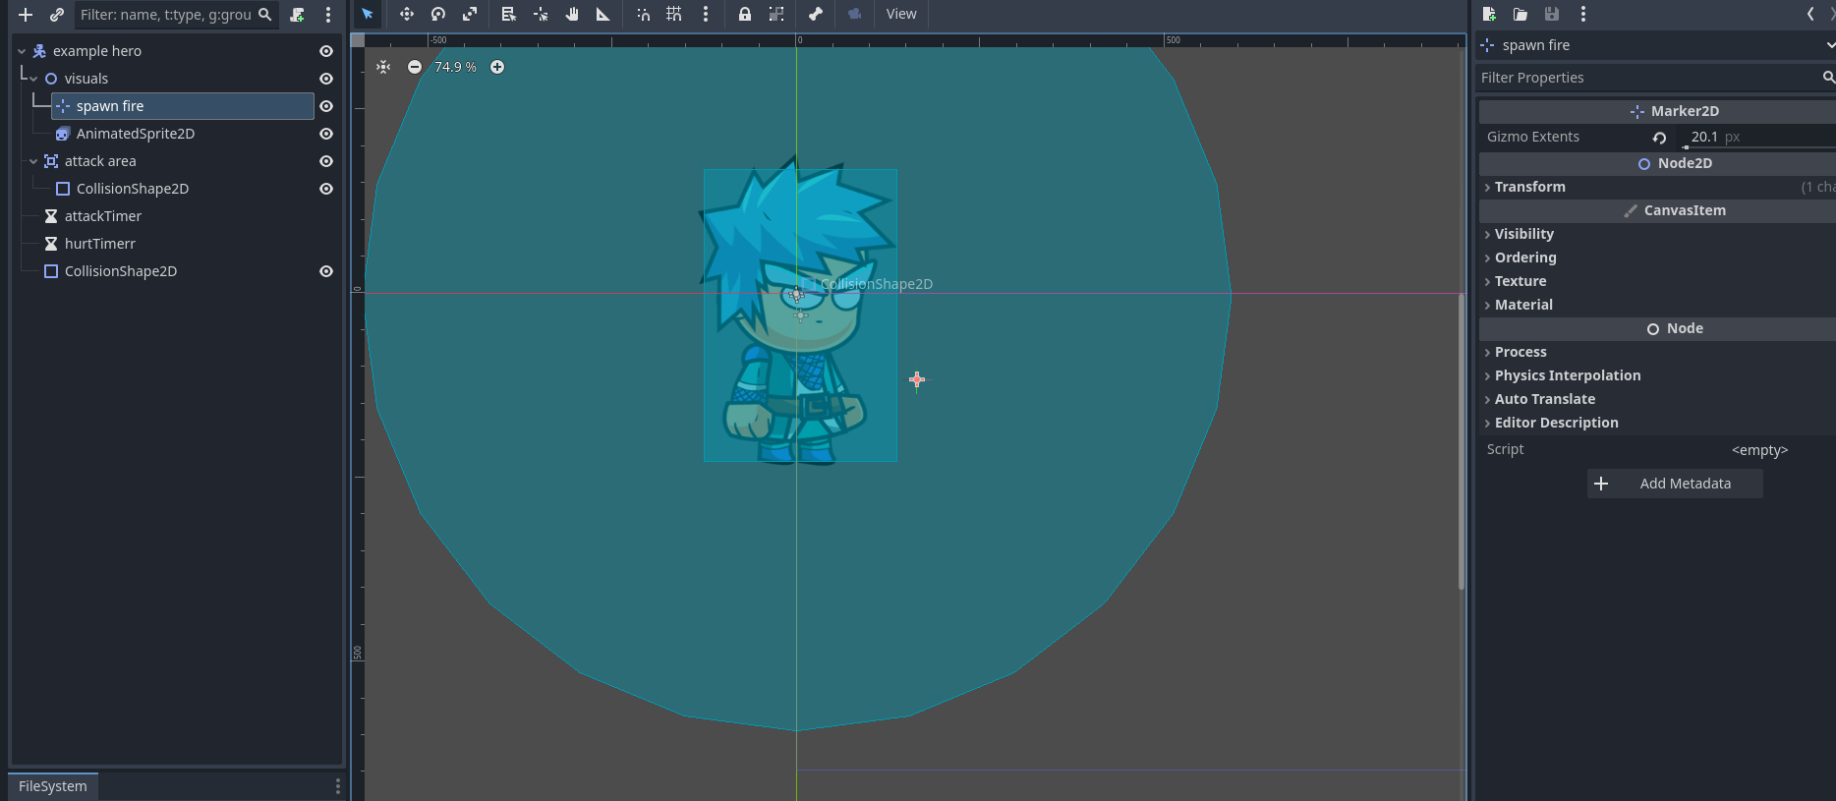
Eighth step
Those timers we will use in code to manage the time of spawning the fire and the time of attack
Add the location from which the fire must spawned

Slide 14
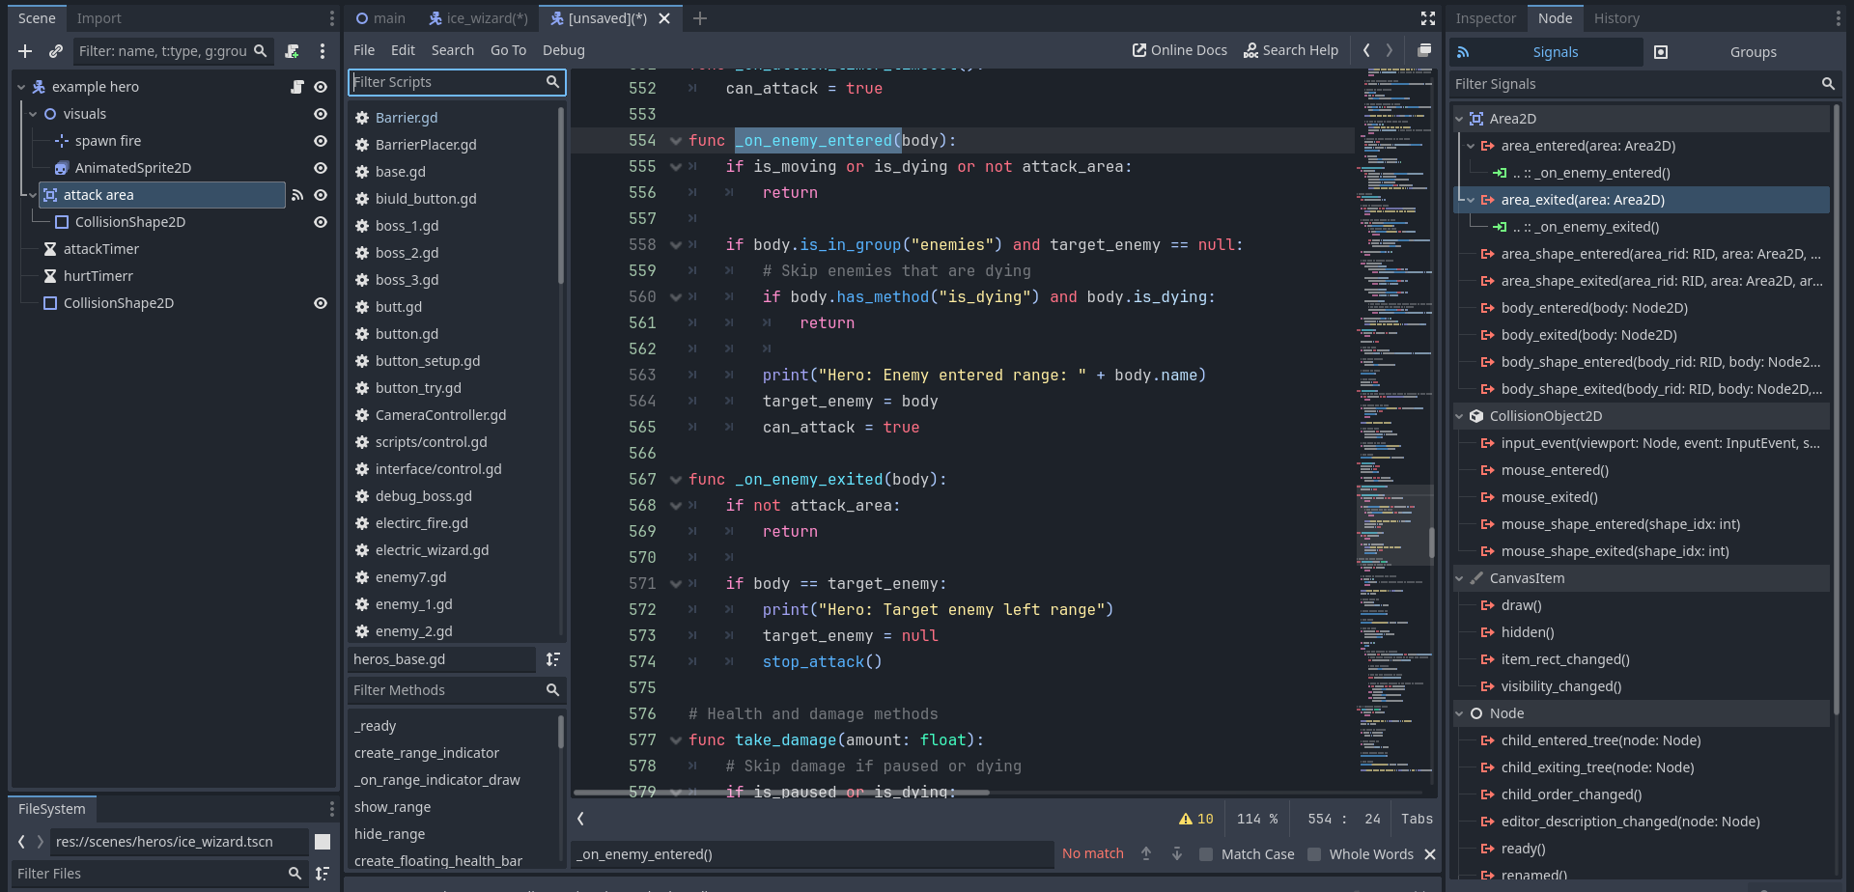
Ninth step
Add the code file and type the necessary code for your character
Connect the signals with the specific function you write
Add the necessary signals for the heroes

Slide 15
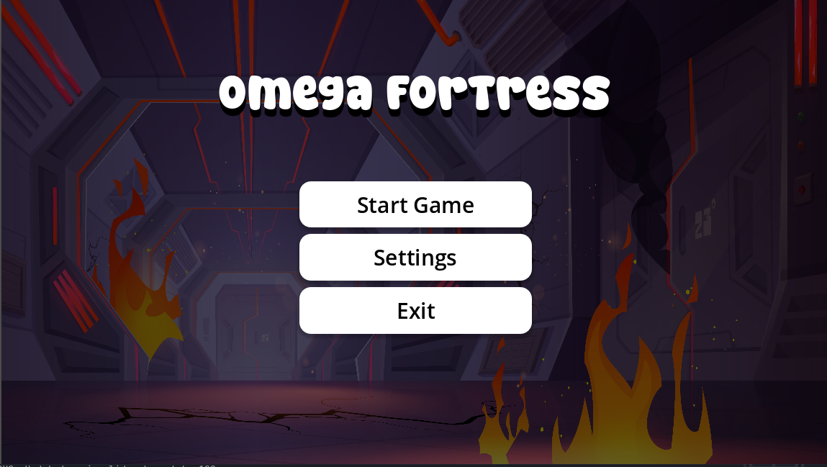
Interface scene
When running the game this is the first interface show
As we can see we have these three button
Let’s start with the setting

Slide 16
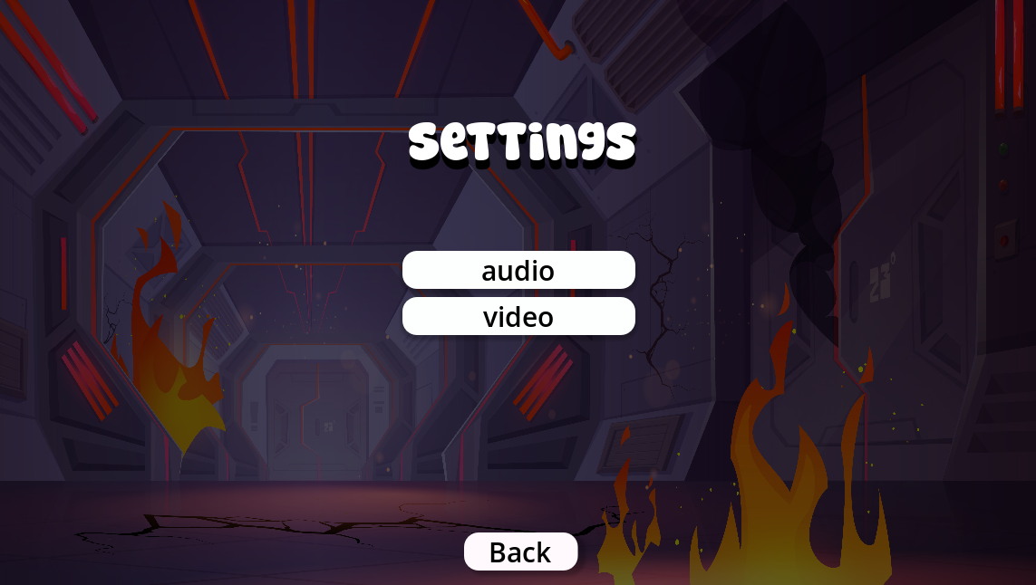
Setting menu scene
This button take us to the audio scene manager
This button take us to the video scene manager
This button take use to the game menu scene

Slide 17
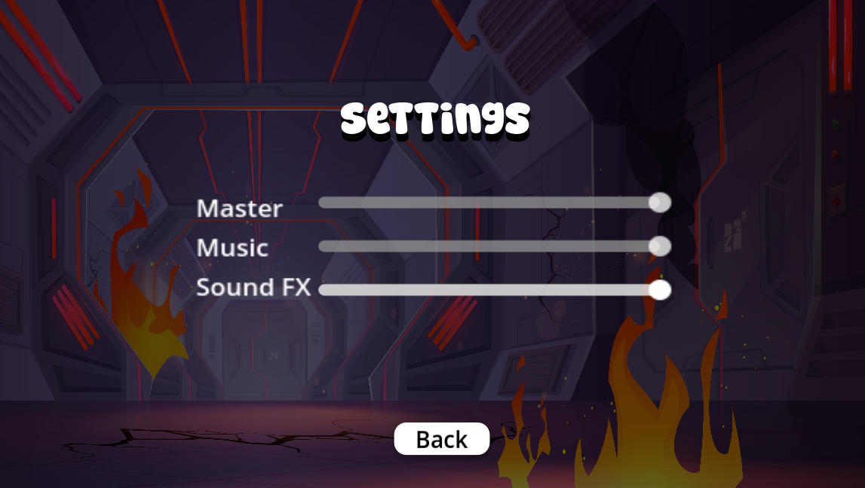
Audio scene
This slider control both of the music and sound audio
This slider control the music audio only
This slider also control the sound audio only
This button take us to the setting scene

Slide 18
Interface scene
Now let’s go to the start game which take us to the map scene

Slide 19
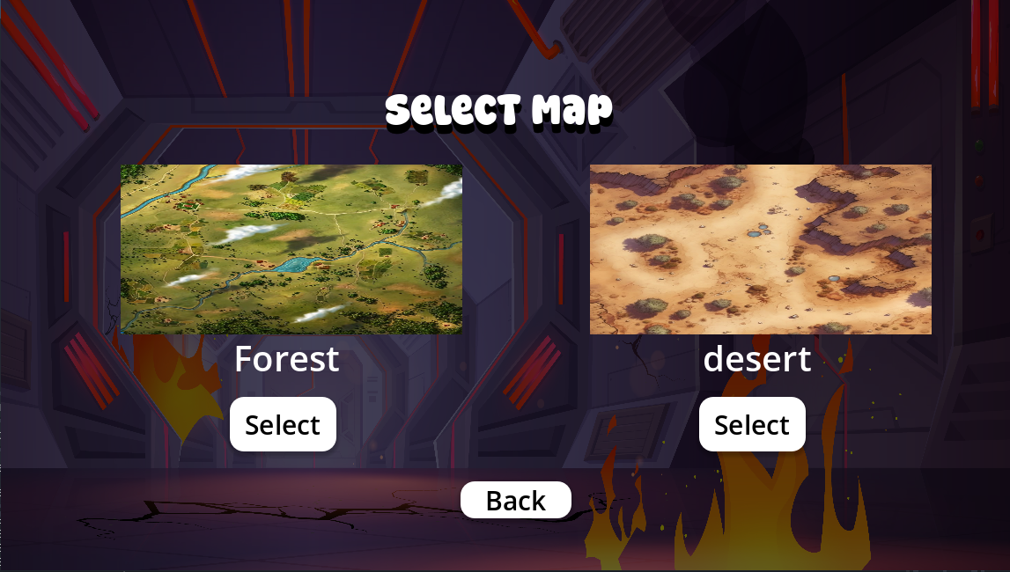
Map scene
Here we have two options by select a map to play on it, which take us the to game scene

Slide 20
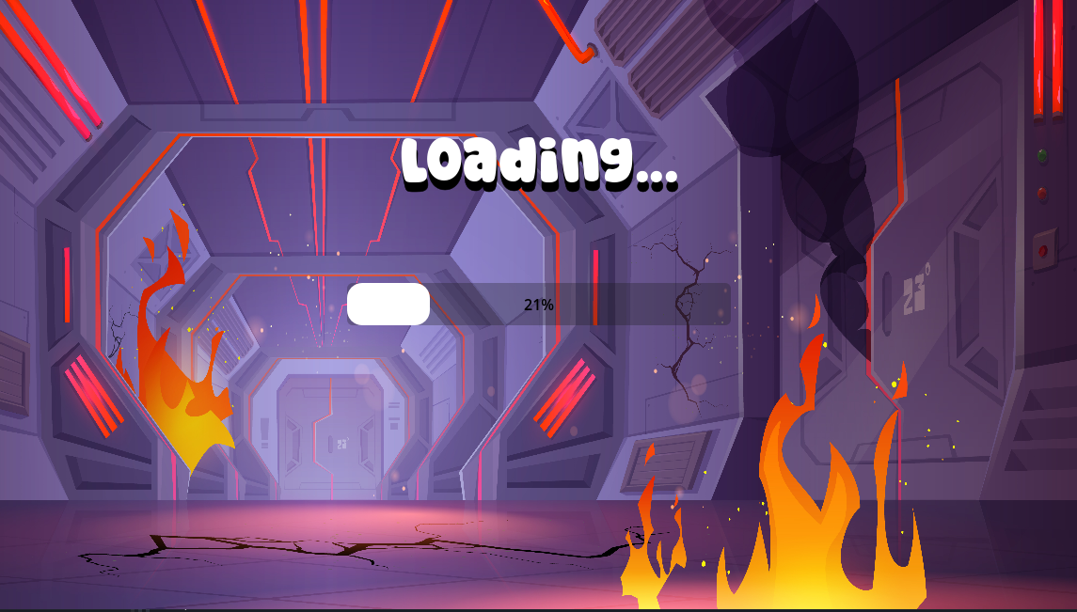
Loading scene
This loading scene it shown before the game starting, the main functionality is to load all the resources needed to run the game

Slide 21
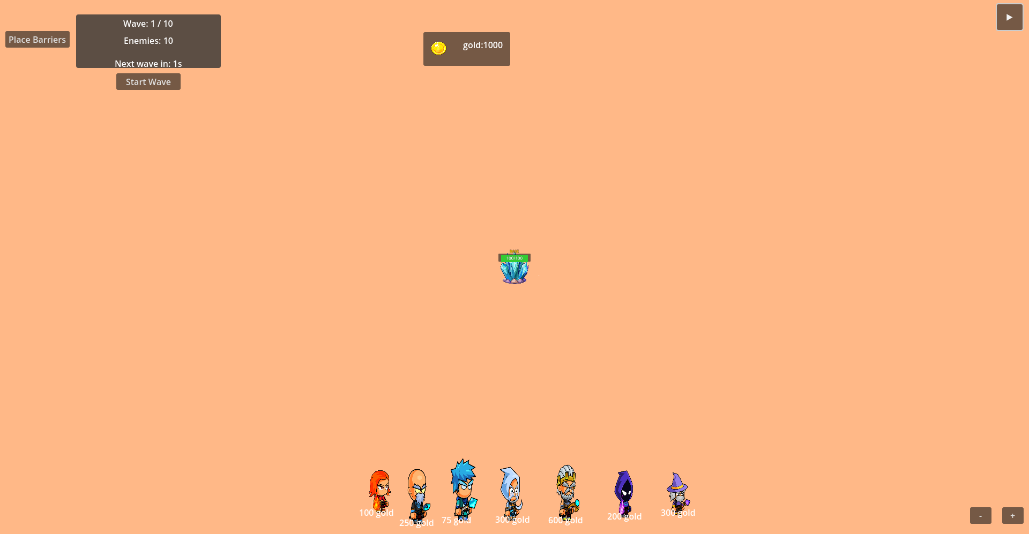
Here we have the game scene
This button for pause and resume the game
This button show the grid system to allow the player place barries
This panel show the amount of the gold we have
This is the base shown on the center of the map
This is the wave display it show the wave information like the number of the wave and the number of the enemies in each wave and the next wave countdown
These two button for the zoom control
Zoom in and out
This is the hero shop that allow the player to purchase hero and place the on the map

Slide 22
Grid System
our grid system is a advanced system for a base defense zone or strategy game. It manages spatial relationships, pathfinding, and game mechanics in a grid-based environment. The using of this grid system:
1. Zone System
2. Barrier System
3. Advanced Pathfinding
4. Base Defense Mechanics
5. Enemy AI path finding Support
6. Hero movement/purchasing Management
7. Path Blocking Detection

Slide 23
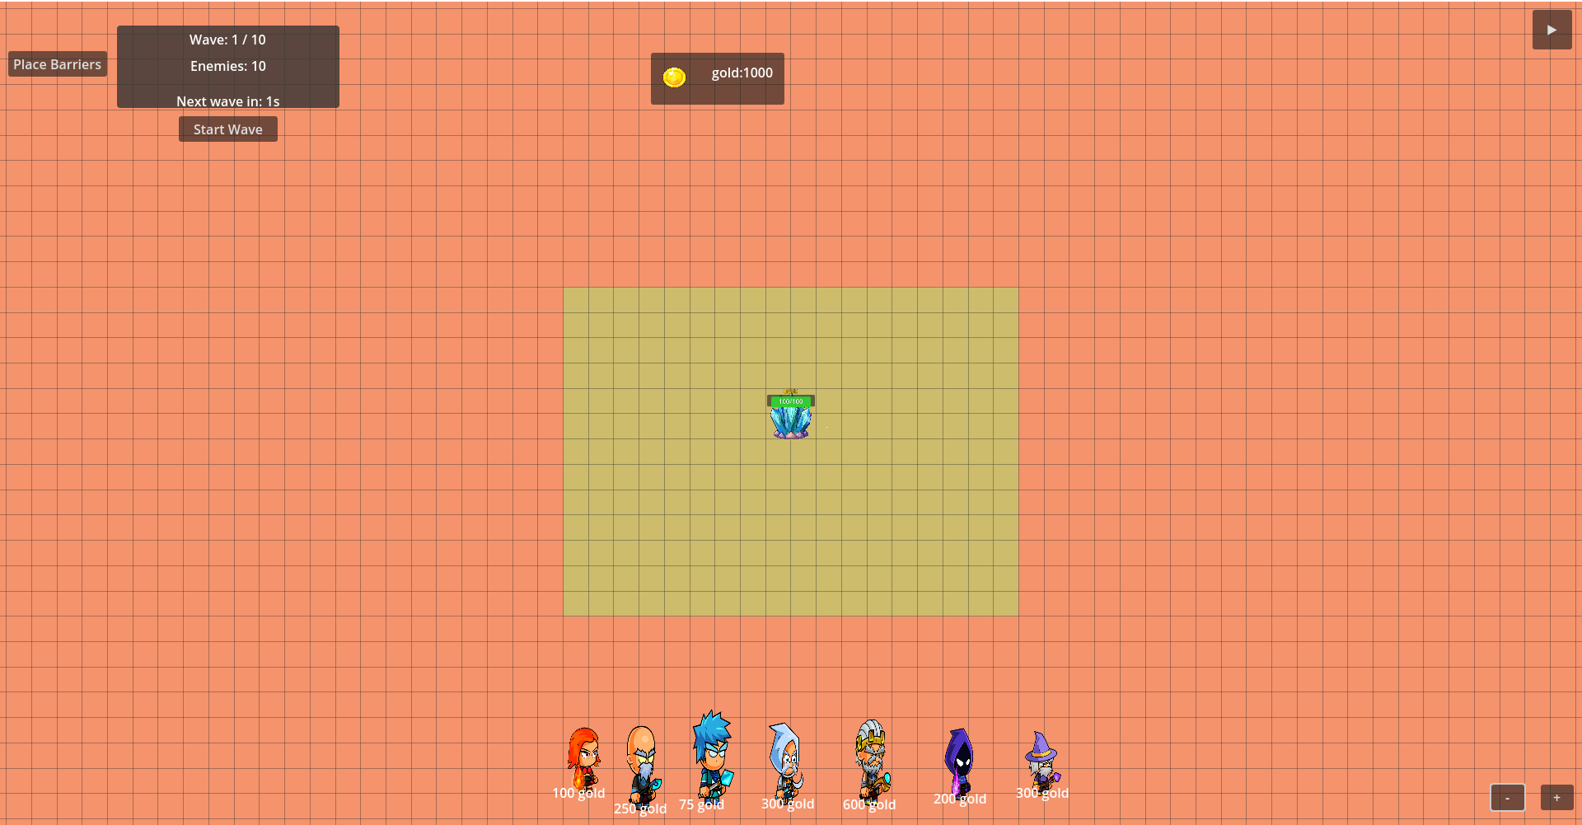
These two pictures show us the grid system design and the zone system

Slide 24
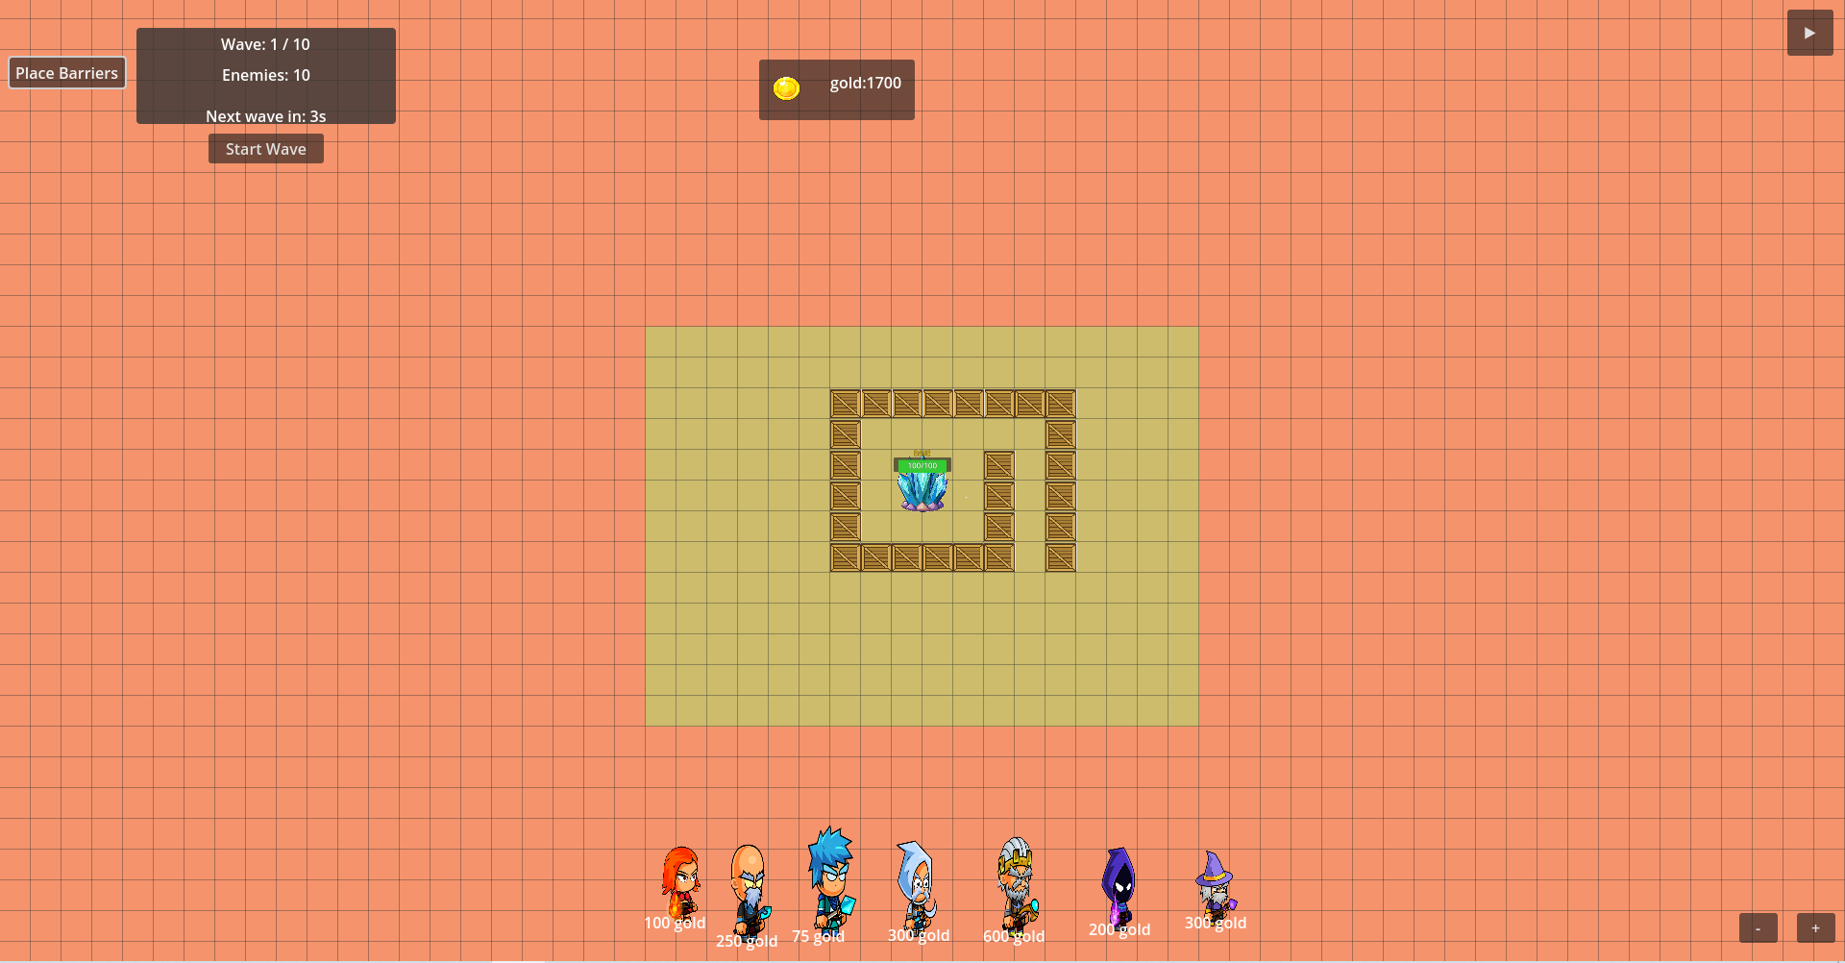
This photo show the place barriers Mechanics
This red zone the player can not be place barriers on it
This green zone the player can place barriers on it

Slide 25
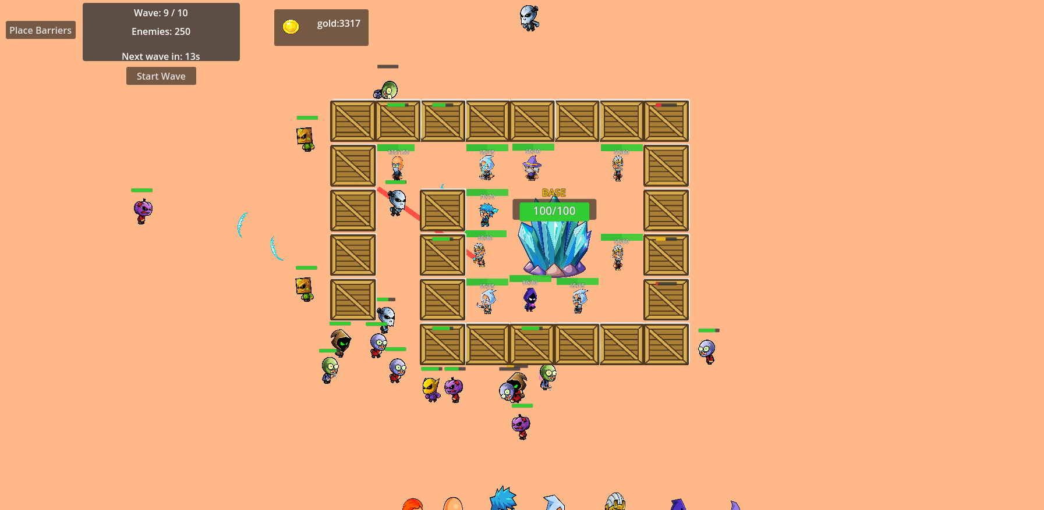
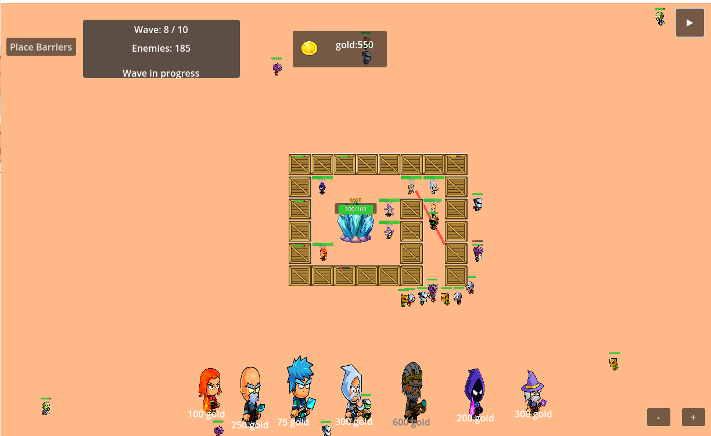
This photo show the enemy ai pathfinding
Here we can see that the player make the path from this side
And here we can see that when the player change the path to this side the enemies take it

Slide 26
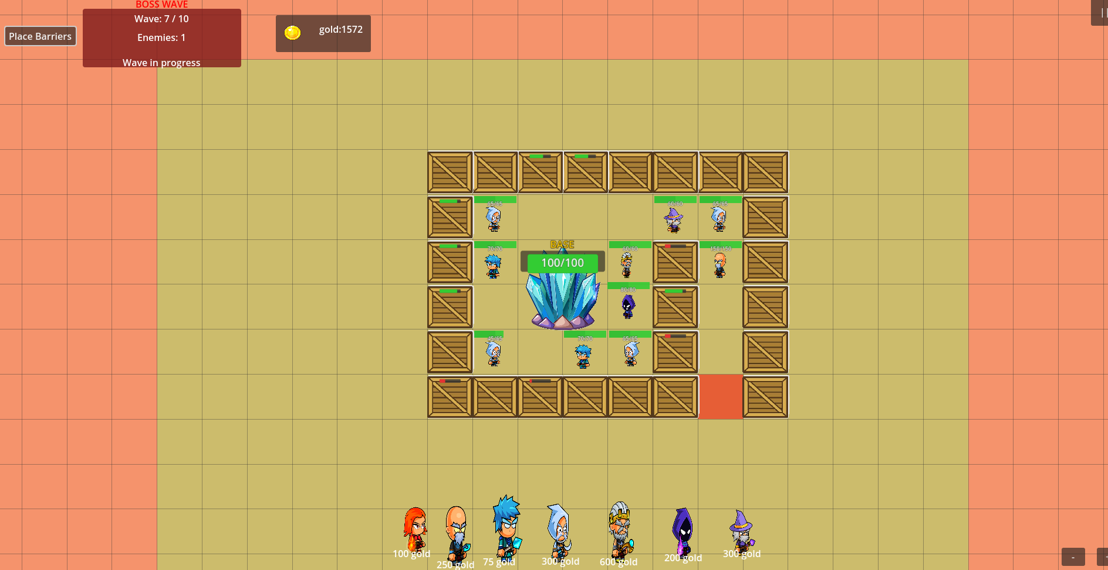
Path Blocking Detection
This photo show that the system detect when the player try to block the path by placing a barrier , so the system prevents him and coloring the cell in red

Slide 27
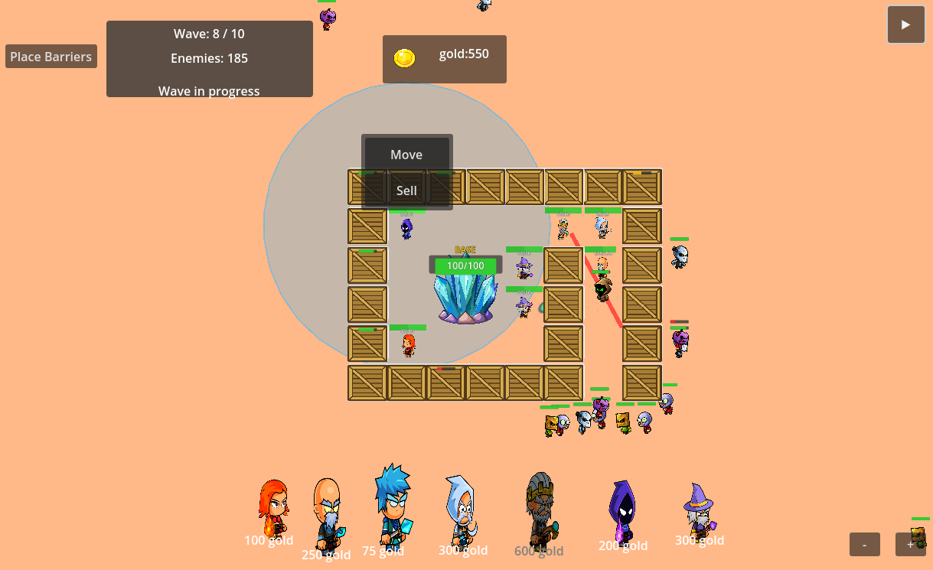
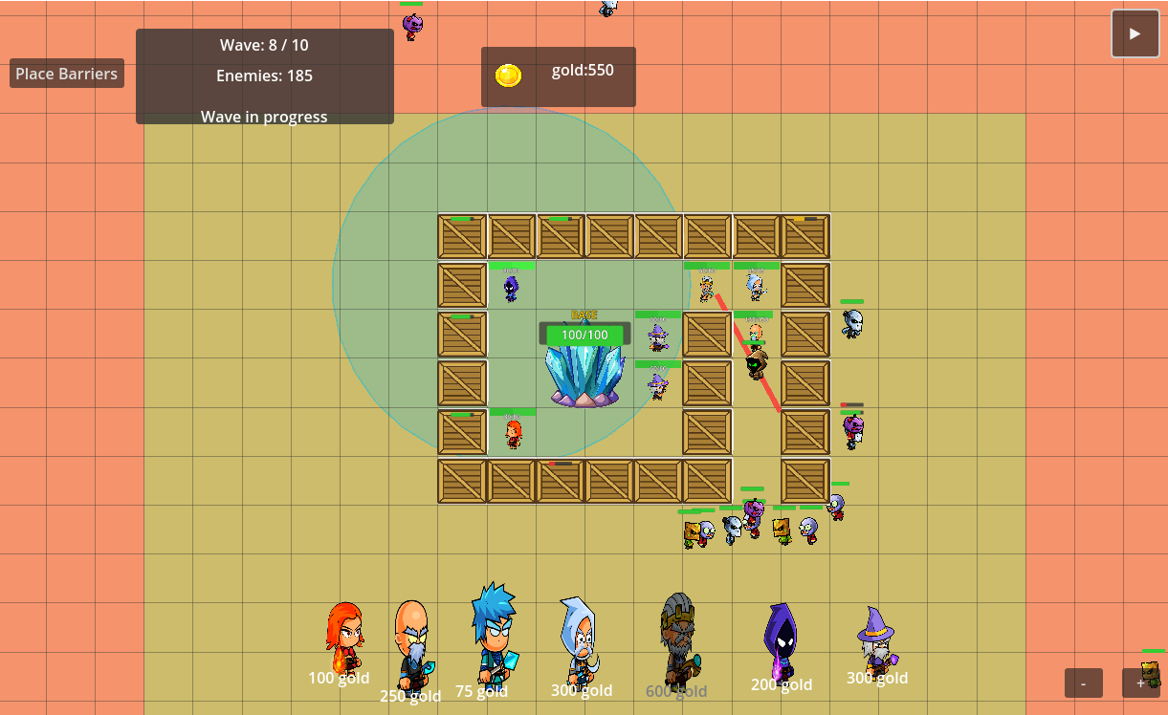
These two photo show us how the grid system control the movement of the heroes
Here when you click on the hero a panel appear, when press on the move button the grid system shown the zones
the player can only move the hero on the green zone and the grid system must check if the cell are empty if yes the hero move otherwise the player cant move

Slide 28
That’s all thank you!!!!

